Slide 1
Driven By Data
Predicting Car Prices
CSC 180 - Final Presentation
Amir Talakoob - 303197362
Phuc Dinh - 302329742
Ian Charamuga - 217500154
Jacob Sullivan - 219877074

Slide 2
Why Predicting car prices?
Public Transportation? Not efficient in all cases
Huge demand among University students
Consequences of Not having a price estimate
Not finding the best option
Losing Money

Slide 3
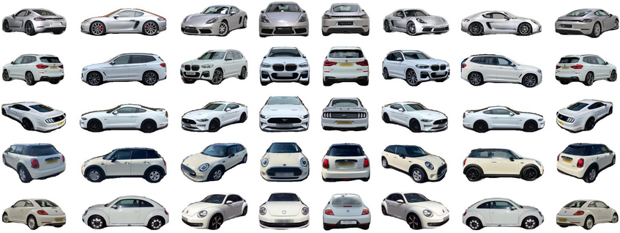
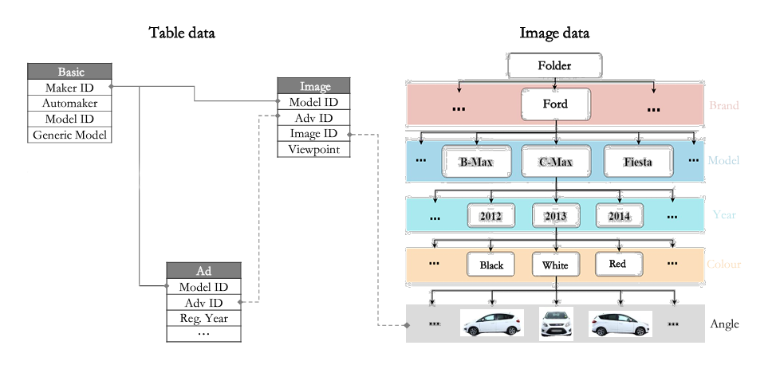
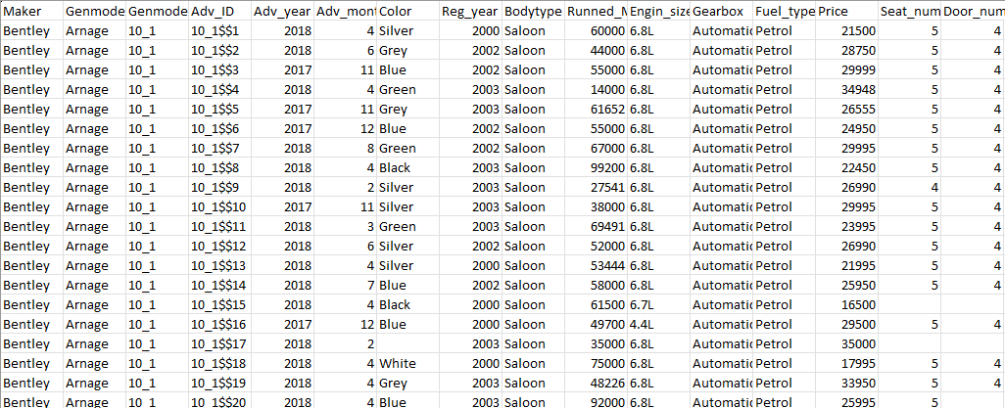
DVM-CAR Dataset
Sale and Specification Data
Ad table
Ad month & year
Spec data: Make, Model, Color, ect.
Image Table
Names of image files
Image data
Multiple 300x300 images of each car
Different angles

Slide 4
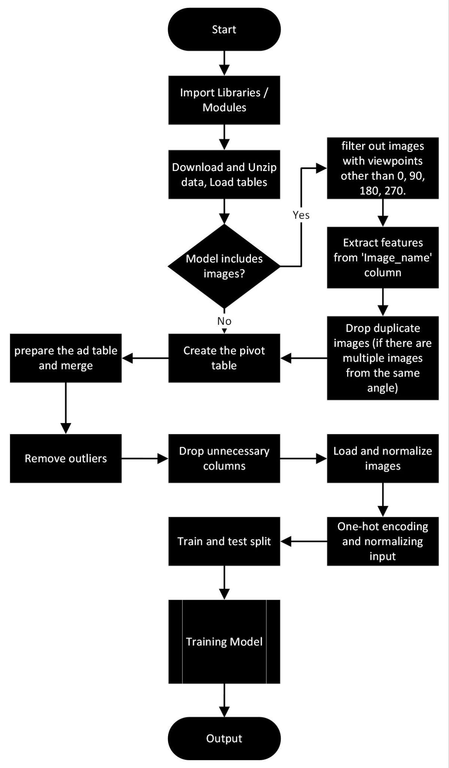
Design of Approach
Flow chart of all of our models:

Slide 5
Experimental Results
Implemented:
Fully Dense Models
3 models
CNN Models
2 models
Hybrid Models (Combination of CNN and Dense)
4 models
Transfer Learning
2 models
Merged photo input vs. 4 separe input images
Worthy of Mention:
Classification Model
Time limitations and scope
RNN (LSTM)
Not possible due to nature of dataset

Slide 6
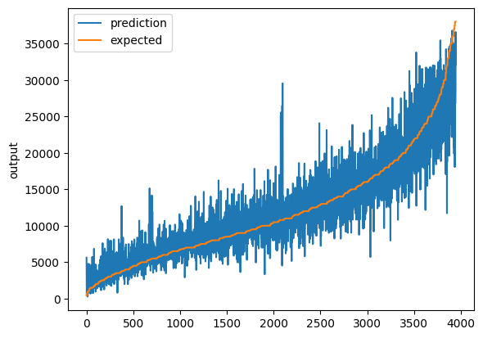
Dense Model
100-50-25-10 Adam Model
RMSE: 2829.184
No Image input
⭐ Best performing dense model

Slide 7
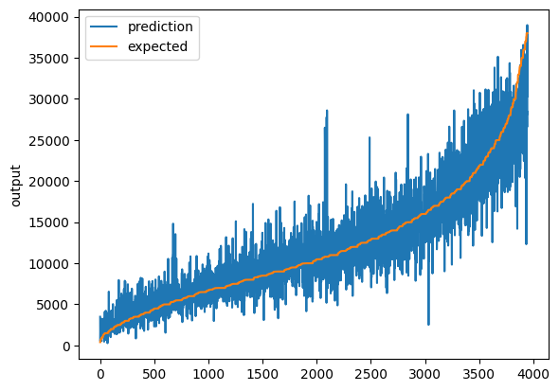
Dense Model
200-150-60-25-10 Adam Model
RMSE: 2832.404
No Image input

Slide 8
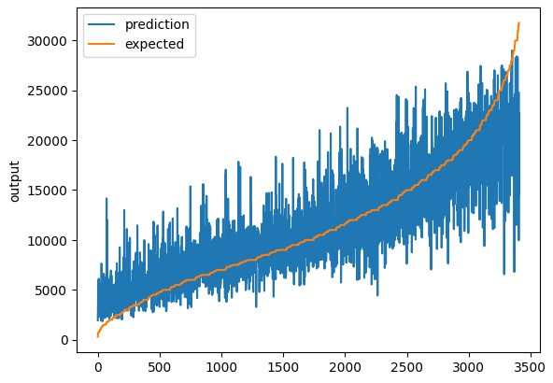
Dense Model
200-150-60-25-10 Adam Model normalized year+month
RMSE: 3227.18
No Image input

Slide 9

Dense Model
200-150-60-25-10 Adam Model one-hot year+month
RMSE: 3228.335
No Image input

Slide 10
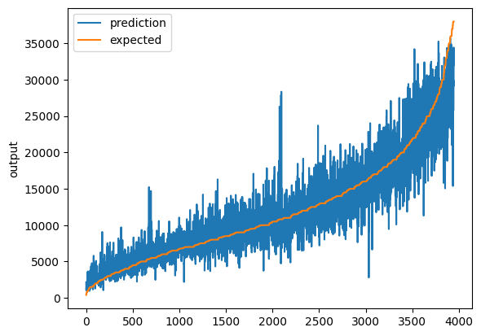
Dense Model
200-150-60-25-10 Adam Tanh 1st Layer Model
RMSE: 2850.730
No Image input

Slide 11
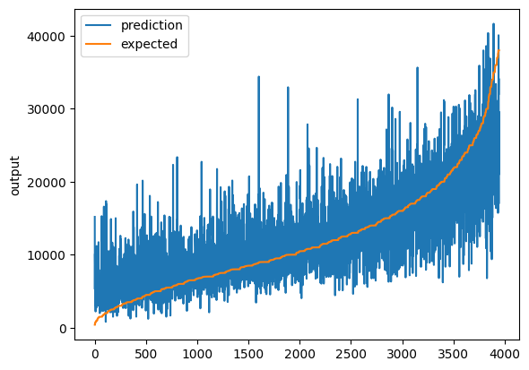
CNN Model
1 VGG Block Model
RMSE: 4565.287
Separate Images Input

Slide 12
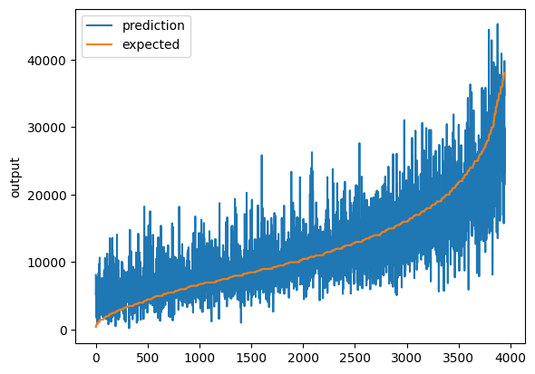
CNN Model
2 VGG Blocks Model
RMSE: 4218.435
Separate Images Input
⭐ Best performing CNN model

Slide 13
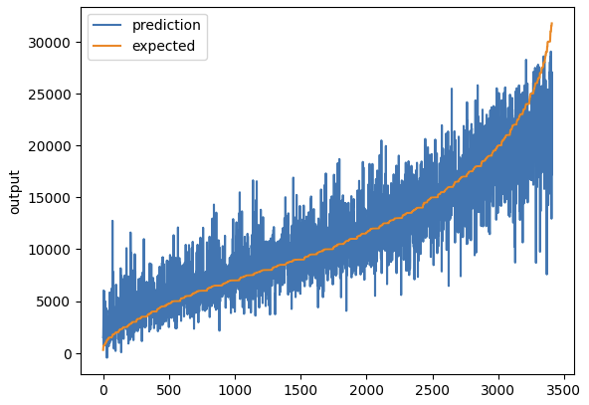
Hybrid Dense/CNN Model
100-50-25-10 Adam | 2 VGG Blocks Model - Front images only - normalize year+month
RMSE: 2878.447
Only 1 image per car (front image)

Slide 14
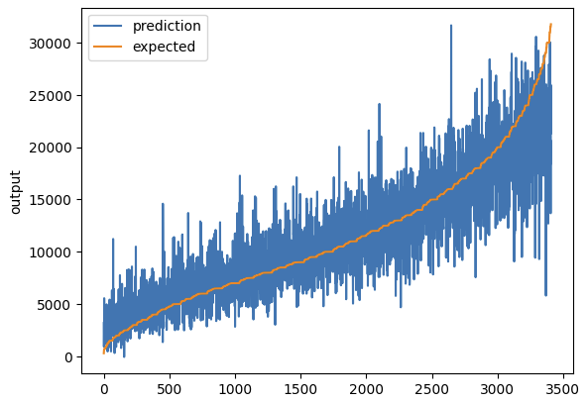
Hybrid Dense/CNN Model
100-50-25-10 Adam | 2 VGG Blocks Model - Front images only - one hot year+month
RMSE: 3032.744
Only 1 image per car (front image)

Slide 15

Hybrid Dense/CNN Model
100-50-25-10 Adam | 2 VGG Blocks Model - 4 Images - normalize year+month
RMSE: 2864.516
4 Separate Images Input

Slide 16
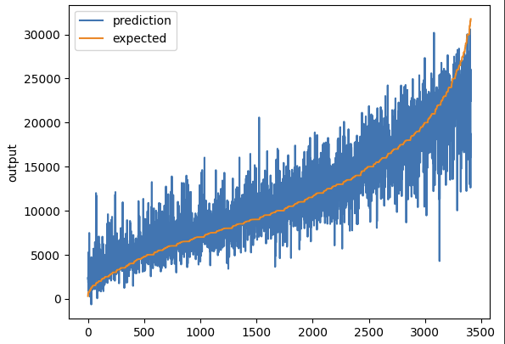
Hybrid Dense/CNN Model
100-50-25-10 Adam | 2 VGG Blocks Model - 4 Images - one hot year+month
RMSE: 2880.030
4 Separate Images Input

Slide 17
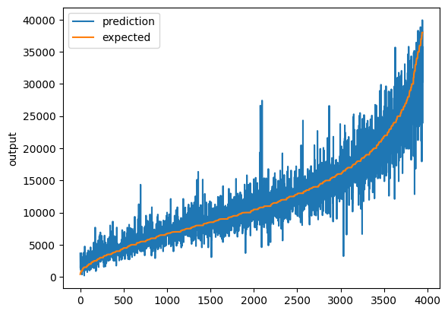
Hybrid Dense/CNN Model
100-50-25-10 Adam | 2 VGG Blocks Model - 4 images - 16k images
RMSE: 2444.381
4 Separate Images Input

Slide 18
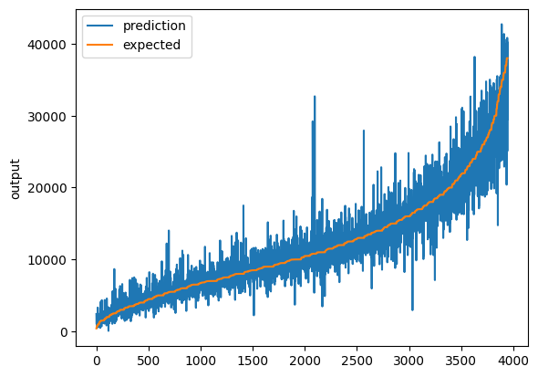
Hybrid Dense/CNN Model
200-150-60-25-10 Adam | 2 VGG Blocks Model - 4 images - 16k images
RMSE: 2390.246
4 Separate Images Input
⭐ Best performing hybrid dense/cnn model
✨ Best overall model

Slide 19
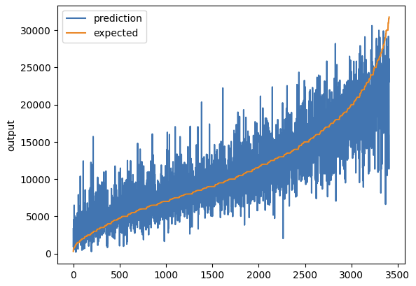
Transfer Learning Hybrid Model
100-50-25-10 Adam | VGG16 - front images - normalize year+month
RMSE: 3393.739
Only 1 image per car (front image)

Slide 20
Transfer Learning Hybrid Model
100-50-25-10 Adam | VGG16 - front images - one hot year+month
RMSE: 3398.765
Only 1 image per car (front image)

Slide 21
Transfer Learning Hybrid Model
100-50-25-10 Adam | VGG16 - 4 images - normalize year+month
RMSE: 3536.498
4 Separate Images Input

Slide 22
Transfer Learning Hybrid Model
100-50-25-10 Adam | VGG16 - 4 images - one hot year+month
RMSE: 3287.807
4 Separate Images Input
⭐ Best performing transfer learning hybrid model

Slide 23
Analysis of Results
Model Performance (best to worst)
Hybrid Dense/CNN
Dense
Transfer learning (VGG16) Hybrid
CNN
Model performance improved by:
Increasing # of layers, neuron count
Increasing # of VGG blocks
Using 4 images per car vs. only 1
Using 4 separate image inputs vs. 1 input with combined photo

Slide 24
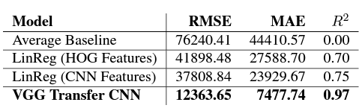
Related Work
Bike and car price estimation from an image input
linear regression with HOG,
Multiclass SVM Baseline
VGG16 for transfer learning
Much smaller dataset
The Price is Right: Predicting Prices with Product Images.
Steven Chen, Edward Chou, Richard Yang.
Stanford University.

Slide 25
Conclusion
Helper Tool to estimate price
University students
Used car price prediction
Given sufficient data, machine learning is a viable way to estimate cost of used cars
Hybrid Dense/CNN models offer best performance
Possible Future Improvements
More fine-tuning of hyper-parameters
Training on higher resolution images

Slide 26
Learning Experience
Finding a topic and dataset
Applying our knowledge/experience on a larger problem
Working on larger datasets
Advantages and disadvantages of different models and their uses
Effect of different ways of input handling and its effect on the output (i.e. combined images vs. four arrays of images)
Other skills we gained:
Speech, presentation
Teamwork
Time management
Applying theory on the coding projects

Slide 27
Thank you!
Any Questions?

